Slide 1



ER Relationship
By EDS & Y
Team 4

Slide 2


TABLE OF CONTENTS
Overview
ER-Diagram
Information Model
Business Rules
Contracts For Selected Behaviour

Slide 3
OVERVIEW
Business Area - The complete student life for EDS & Y Institute.
EDS & Y Institute is a leading educational institution dedicated to holistic student development, combining rigorous academics with vibrant campus life.
The Complete Student Life initiative integrates academics, events, activities, health services, career services, and alumni engagement into one seamless experience.

Slide 4
INTRODUCTION
Entity-Relationship (ER) Diagrams: Help visualize and design the database structure by clearly showing entities, attributes, and relationships.
Information Models: Extend ER models by including business rules, subtypes, and dynamic behaviors, making systems more flexible and reflective of real-world operations.
Purpose of this project:
To organize and represent complex student life data systematically.
To identify key entities like Students, Courses, Events, Clubs, etc.
To prepare a reliable, scalable system supporting student needs across multiple services.

Slide 5
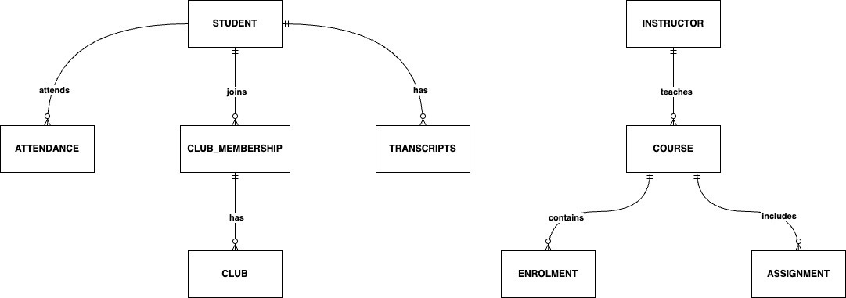
BASIC ER-DIAGRAM

Slide 6
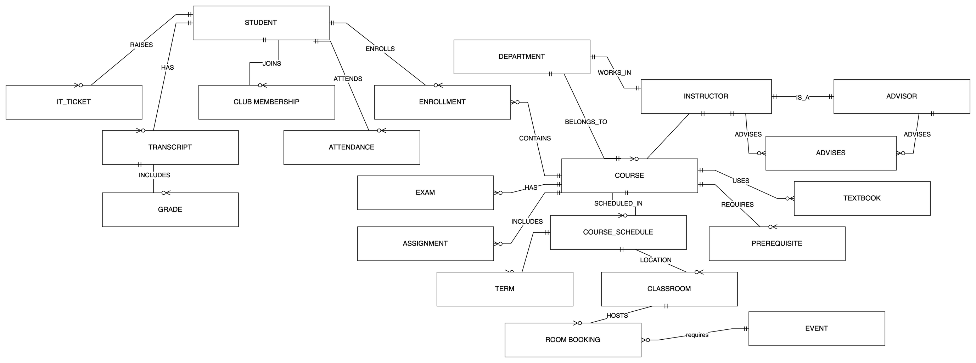
ER Diagram

Slide 7
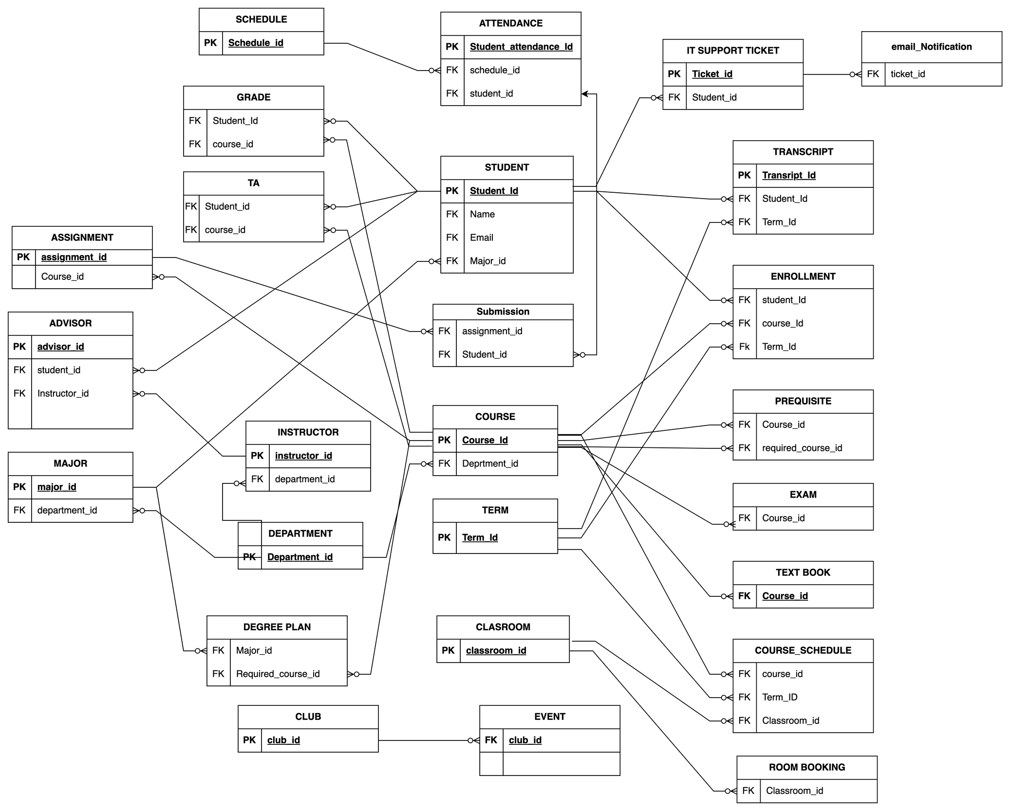
ADVANCE ER-DIAGRAM

Slide 8
The PRIMARY KEYS & THE FOREIGN KEYS AND THEIR RELATIONS WITH THE ENTITIES
The entities in this database schema are: STUDENT, COURSE, TERM, ENROLLMENT, GRADE, TRANSCRIPT, COURSE_SCHEDULE, CLASSROOM, DEPARTMENT, INSTRUCTOR, MAJOR, PREREQUISITE, EXAM, TEXTBOOK, ADVISOR, SCHEDULE, ATTENDANCE, CLUB, EVENT, ROOM_BOOKING, IT_SUPPORT_TICKET, EMAIL_NOTIFICATION, DEGREE_PLAN, ASSIGNMENT, SUBMISSION, and TA.
Primary Key (PK):
A Primary Key uniquely identifies each row in a table.
It cannot be null or duplicate.
Example: In STUDENT, student_id is the PK (each student has a unique ID).
Foreign Key (FK):
A Foreign Key links one table to another by referring to a Primary Key.
It shows relationships between tables and ensures data consistency.
Example: In ENROLLMENT, student_id is an FK that refers to STUDENT.student_id.
Relationships Between Entities (Simplified):
STUDENT:
PK: student_id
FK: major_id → MAJOR
COURSE:
PK: course_id
FK: department_id → DEPARTMENT
ENROLLMENT:
PK: student_id + course_id + term_id
FKs: student_id → STUDENT, course_id → COURSE, term_id → TERM
GRADE:
PK: student_id + course_id
FKs: student_id → STUDENT, course_id → COURSE
COURSE_SCHEDULE:
PK: course_id + term_id + classroom_id
FKs: course_id → COURSE, term_id → TERM, classroom_id → CLASSROOM
PREREQUISITE:
PK: course_id + required_course_id
FKs: course_id → COURSE, required_course_id → COURSE
Other Key FK Examples:
INSTRUCTOR: department_id → DEPARTMENT
ADVISOR: student_id → STUDENT, instructor_id → INSTRUCTOR
ATTENDANCE: schedule_id → SCHEDULE, student_id → STUDENT
EXAM, TEXTBOOK, ASSIGNMENT: course_id → COURSE
SUBMISSION: assignment_id → ASSIGNMENT, student_id → STUDENT
IT_SUPPORT_TICKET: student_id → STUDENT
EMAIL_NOTIFICATION: ticket_id → IT_SUPPORT_TICKET
DEGREE_PLAN: major_id → MAJOR, required_course_id → COURSE
TA: student_id → STUDENT, course_id → COURSE
Summary:
Primary Keys uniquely identify records.
Foreign Keys connect tables (relationships).
Example: STUDENT enrolls in COURSE via ENROLLMENT (linked by FKs).
All Primary Keys (PK):
STUDENT: student_id.
COURSE: course_id
TERM: term_id
CLASSROOM: classroom_id
DEPARTMENT: department_id
INSTRUCTOR: instructor_id
MAJOR: major_id
IT_SUPPORT_TICKET: ticket_id
SCHEDULE: schedule_id
CLUB: club_id
ASSIGNMENT: assignment_id
All Foreign Keys (FK):
ENROLLMENT: student_id → STUDENT
ENROLLMENT: course_id → COURSE
ENROLLMENT: term_id → TERM
GRADE: student_id → STUDENT
GRADE: course_id → COURSE
TRANSCRIPT: student_id → STUDENT
TRANSCRIPT: term_id → TERM
COURSE_SCHEDULE: course_id → COURSE
COURSE: department_id → DEPARTMENT
INSTRUCTOR: department_id → DEPARTMENT
STUDENT: major_id → MAJOR
MAJOR: department_id → DEPARTMENT
PREREQUISITE: course_id → COURSE
PREREQUISITE: required_course_id → COURSE
EXAM: course_id → COURSE
TEXTBOOK: course_id → COURSE
ADVISOR: student_id → STUDENT
ADVISOR: instructor_id → INSTRUCTOR
ATTENDANCE: schedule_id → SCHEDULE
ATTENDANCE: student_id → STUDENT
EVENT: club_id → CLUB
ROOM_BOOKING: classroom_id → CLASSROOM
IT_SUPPORT_TICKET: student_id → STUDENT
EMAIL_NOTIFICATION: ticket_id → IT_SUPPORT_TICKET
DEGREE_PLAN: major_id → MAJOR
DEGREE_PLAN: required_course_id → COURSE
ASSIGNMENT: course_id → COURSE
SUBMISSION: assignment_id → ASSIGNMENT
SUBMISSION: student_id → STUDENT
TA: student_id → STUDENT
TA: course_id → COURSE

Slide 9
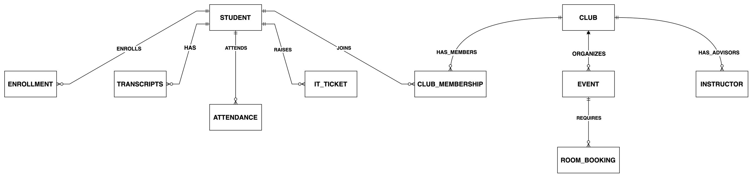
ER Diagram for Student Activities

Slide 10
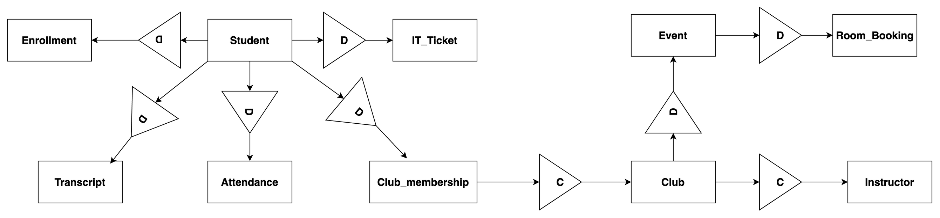
Info model for Student Activities

Slide 11
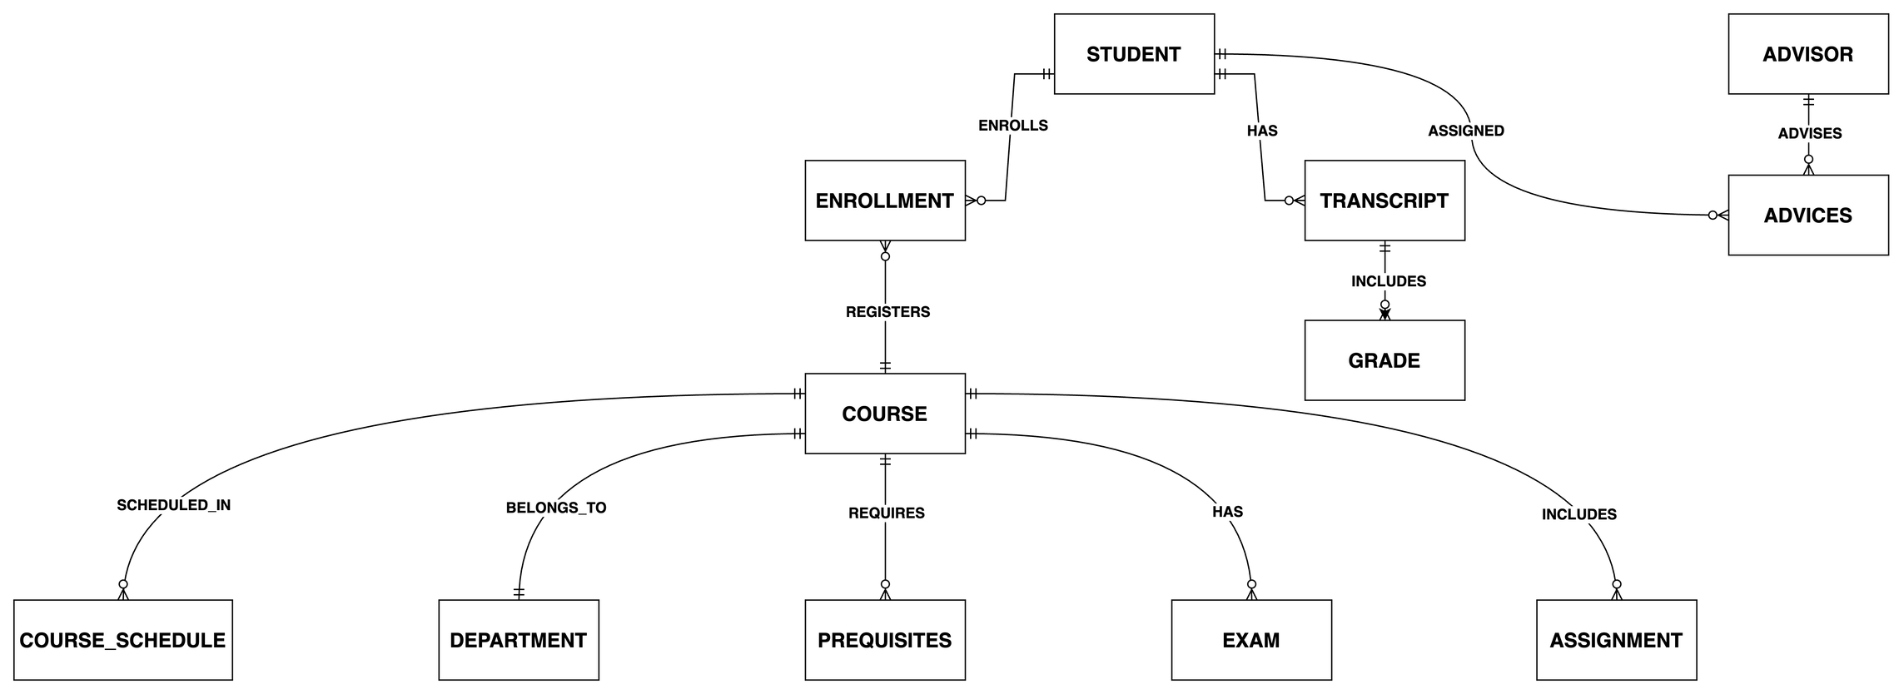
ER diagram for Student Registration

Slide 12
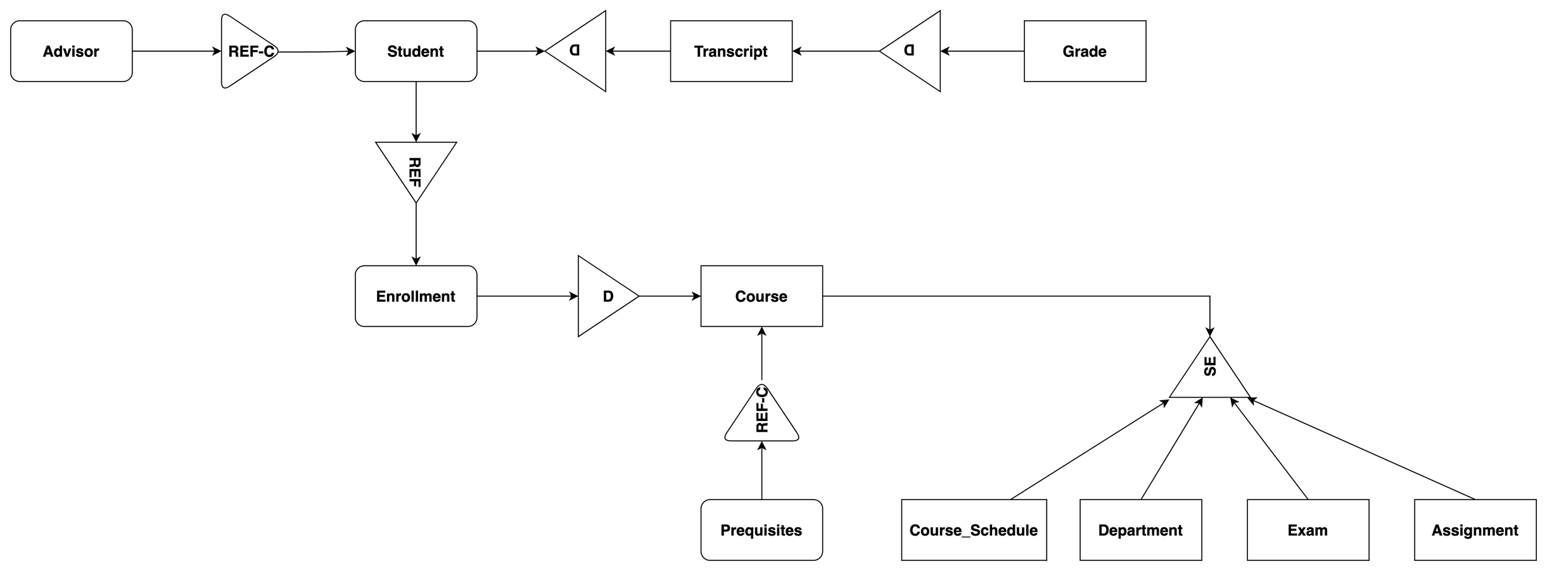
Info model for Student Activities
Info Model for Student Registration

Slide 13
Contracts for Student Activity
Invariant:
The student must have a valid identity and enrollment record within the institution’s database.
Pre-Conditions:
Students must complete admission requirements.
Student records must be created and verified by the administration.
Students must submit valid personal and academic information.
Advisors must be assigned for academic guidance.
Post-Conditions:
Students can enroll in courses and participate in academic activities.
Students’ progress and attendance are tracked.
Students can access IT services, clubs, and other institutional facilities.
Students’ academic history is recorded through transcripts.
Trigger:
The students’ admission process is initiated, and the student profile is created in the database.

Slide 14
Classroom and Room Booking
Invariant:
Every course must have a valid scheduled classroom assigned for conducting sessions.
Pre-Conditions:
Room must be available and not already booked for the scheduled time slot.
Course details (instructor, number of students) must be confirmed.
Room booking must be approved by the academic or facilities management team.
Post-Conditions:
Classroom assignment is confirmed and scheduled.
Booking record is updated in the room booking system.
Any events hosted will use booked rooms following institutional policies.
Trigger:
Course scheduling process requires a classroom or an event needs to book a room.

Slide 15
Course Selection and Academic Progress
Invariant:
Students must meet course prerequisites before enrolling.
Pre-Conditions:
Student must have an active enrollment record for the term.
Prerequisites for selected courses must be satisfied.
Instructor assignments and course schedules must be finalized.
Departmental approval (if required) must be obtained.
Post-Conditions:
Student’s enrollment in courses is confirmed.
Transcript and attendance records are updated accordingly.
Student gains access to course materials, assignments, and exams.
Academic advisor may update academic progress tracking.
Trigger:
Student initiates course registration at the start of an academic term.

Slide 16

Thank You
By EKAGRA JAIN
DEVANSH GUPTA
SAI KIRAN CHOWDARY
&
YASHIKA HEMNANI

